Slide 1
Drone Phenology Monitoring
Gaurav Rajput
Parth Thakur

Slide 2
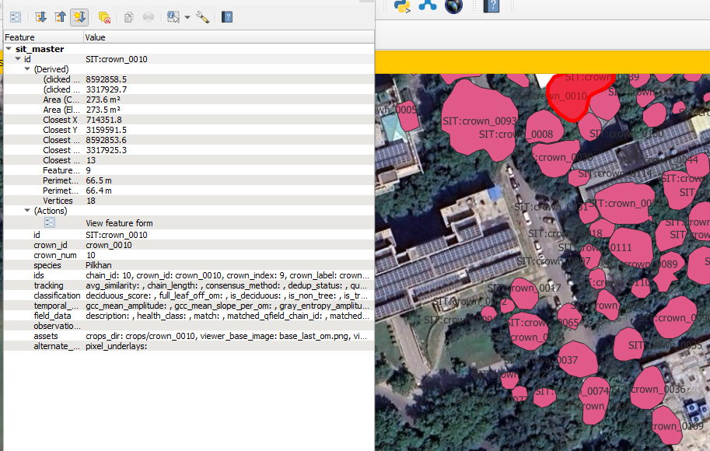
Master GeoJSONs

Slide 3
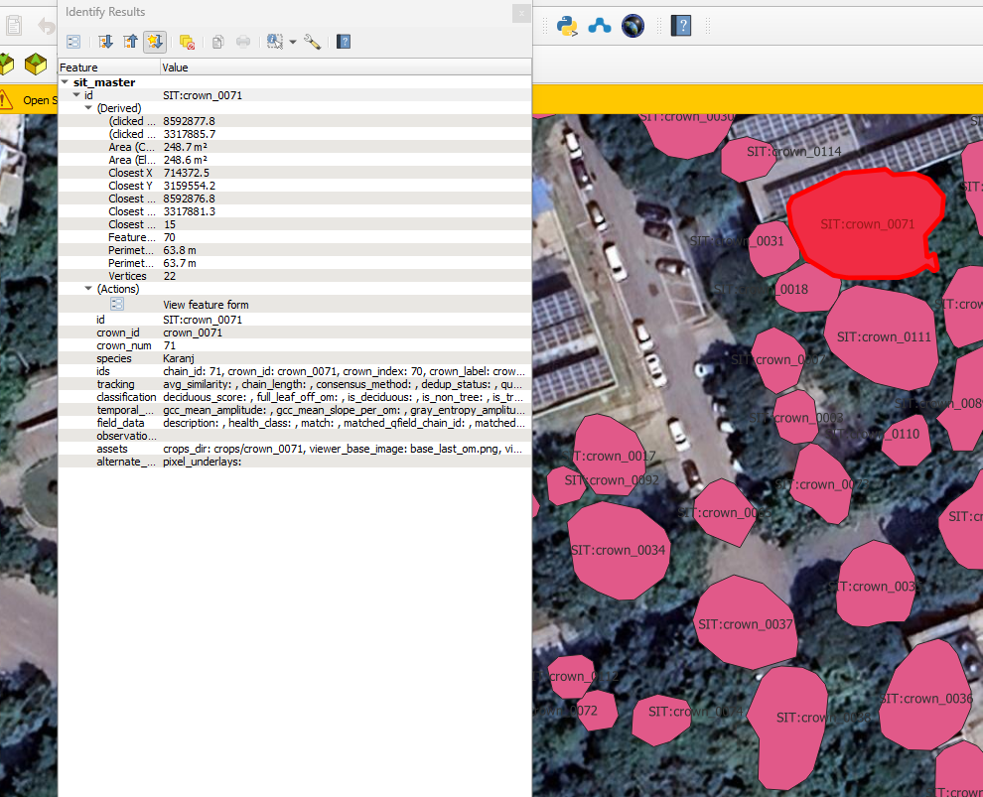
Master GeoJSONs

Slide 4
Sanjay Van Data added to Phenology Mapping Sheet
Only 4 new species
Kanju
Prosopis Juliflora
Subabool
Teak
Existing: Amaltas, Bamboo, Banyan, Karanj, Native acacia, Neem, Peepal

Slide 5
Pipelined Execution
Step 0: Discover OMs → pipeline_config.json
Step 1: Crown Detection → multithreshold GPKGs (Detectree2)
Step 2: Crown Tracking → consensus_crowns_complete_all.gpkg
Step 3: Phenology Analysis → tree_master_geojson.geojson
Step 4: Interactive Viewer

Slide 6
Step 2: Crown Tracking
Alignment — PCC (Phase Cross-Correlation) on conf_0p65 layer to compute per-OM pixel shift (dx, dy)
Graph build
Chain assembly — extract full chains → branching backbones → partial chains (len ≥ 5, one-to-one ratio ≥ 0.9) → deduplication

Slide 7
Step 3: Phenology Analysis
Extract image patch → compute vegetation indices (NDVI proxy, hue, brightness)
Normalize per-crown across time
Score leafshed intensity and assign phenophase
Output: tree_master_geojson.geojson

Slide 8
python 00_discover_oms.py \
--om-dir input/input_om_sit \
--output-dir output/sit_pipeline_fixed \
--crowns-dir output/detectree_om_sit_multithreshold/crowns_multithreshold \
--exclude-stems lhc_om2
conda run -n detectree python 02_crown_tracking.py \
--config output/sit_pipeline_fixed/pipeline_config.json \
--base-threshold-tag conf_0p15 \
--skip-chain-viz --skip-consensus-viz --skip-diagnostics
conda run -n detectree python 03_phenology_analysis.py --config ...
conda run -n detectree python 04_interactive_viz.py --config ...

Slide 9
Data on CSE Filer
LHC: 13 OMs
SIT: 19 OMs Sanjay Van: 8 in Spot 1-3, 6 in Spot 4
Set up script copy_to_filer.ps1
Spins up a temp --privileged Docker container from nfs_mount_img, which bind-mounts your local source at /source and mounts the NFS filer at /mnt/filer, then runs rsync

